Slide 1
Student time table management system
Shubham Upadhyay
Prashant Kumar

Slide 2
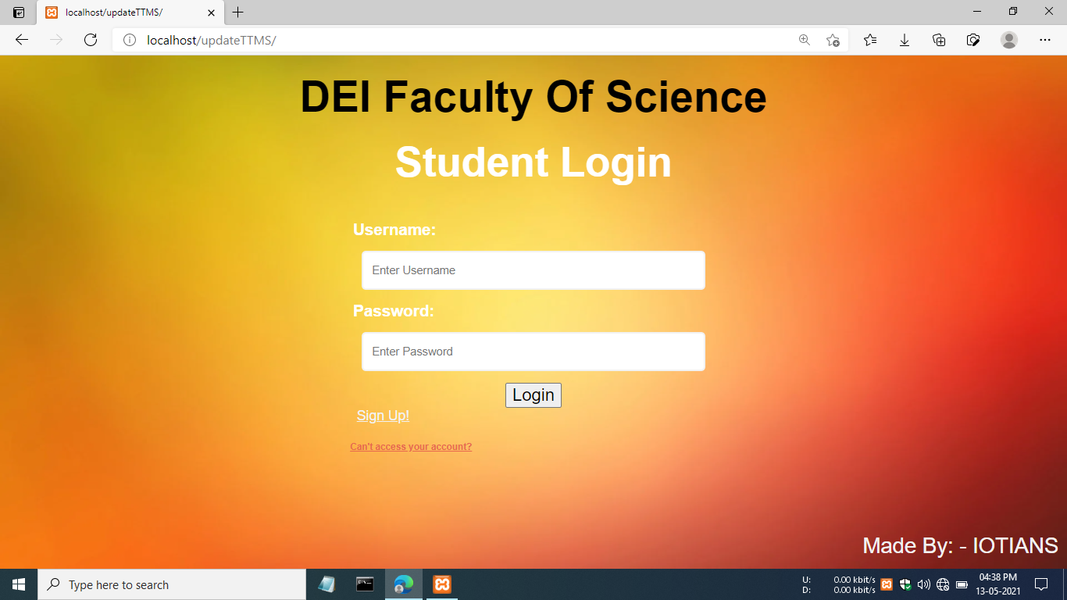
Introduction
In College, Universities, We saw a Time Table of Student classes.
To solve this problem , We create a Website & Mobile Application Which shows weekly time table of students in a serial monitor.
This website / mobile application shows student time table publically.

Slide 3
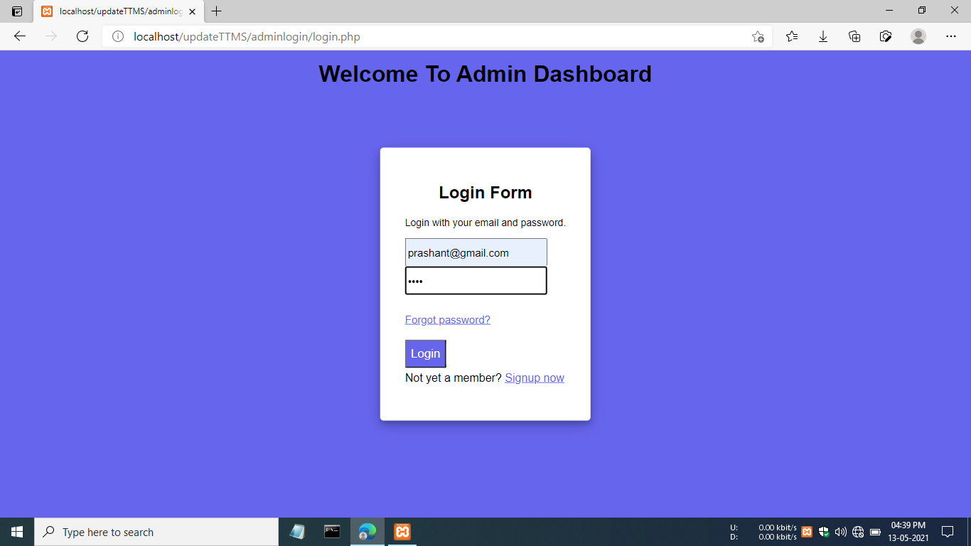
Objectives
This project will helps College/Universities ‘s Administrator to manage easily whole Classes & Exam time table of students
It will also helpful for students also, Any student saw classes time table from any place , any where with 24X7
This will apply in Universities , Colleges , Schools also.

Slide 4
Requirements
Hardware
Raspberry-Pi
Monitor
Software
Xammp

Slide 5
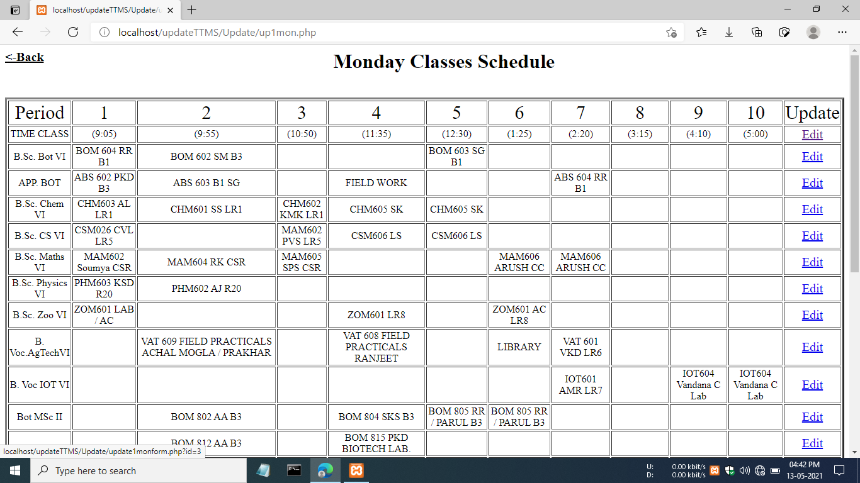
Advantages
This project can apply in Schools, Colleges, Universities , Government and private sectors also.
It reduces global warming.
Easily edit / Change Time Table by the administrator when needs
Students can access website / Application on their android mobile 24X7.

Slide 6
Thank You

